Slide 1
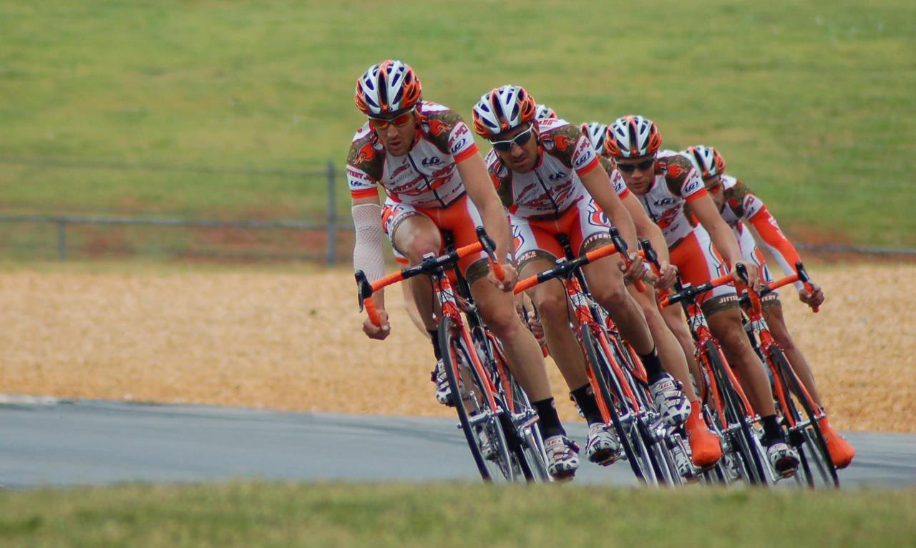
The Power of Leverage - GMTSS

Slide 2
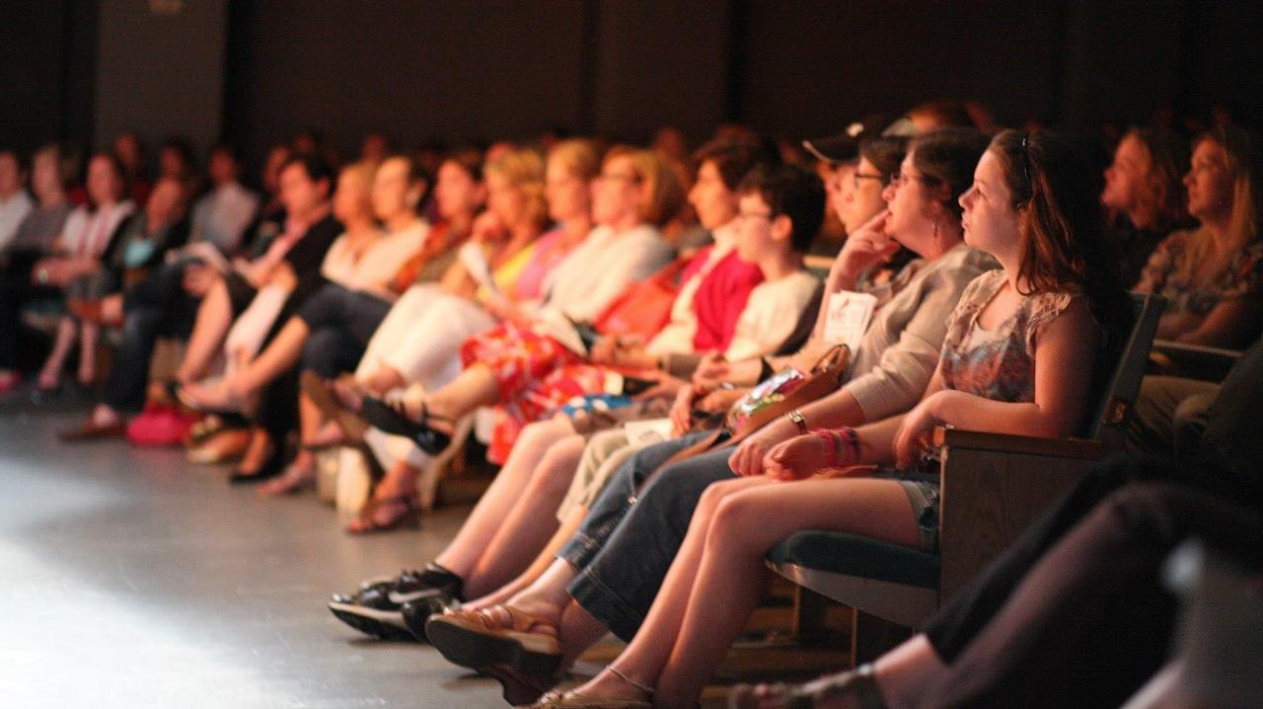
GMTSS
Global
Meeting
Training
Seminar
System

Slide 3
History of the GMTSS
Started in US
Moving from Home to Home
Need for Bigger meeting arise
Move into Small Meeting

Slide 4

What is GMTSS?
A one-of-a-kind, powerful business tool
01
Design specifically with UFO in mind
02
It enable UFOs to build their business anywhere
03
04
An worldwide and open system
Network of meetings can be use to train UFOs and prospects
05

Slide 5
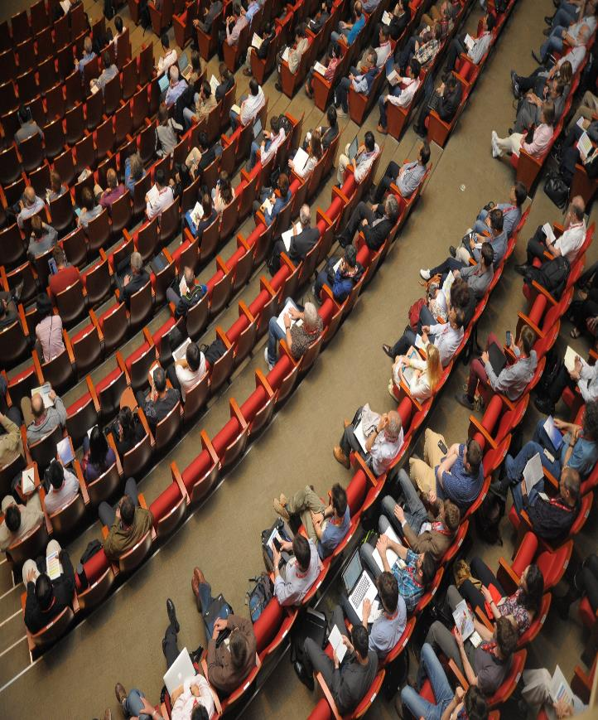
Importance of GMTSS
01
The nervous system of the business
Provide Systemisation, Uniformity, Standardisation just like Franchise System
02
03
This differentiate us from those in Direct sales industry
It allows one to secure business at home and grow internationally
04

Slide 6
Importance of GMTSS
Provide correct information through standardised training
05
To prevent predators or unethical people exploiting chargeable meetings and training
06
Speakers and Trainers are held to a higher standard and must be beyond reproach.
07
08
The whole is greater than the sum from the parts.

Slide 7

GMTSS Benefits
Leverages Time
Promotes Teamwork
Standardise Ticket Prices
Creates Recognition System

Slide 8
GMTSS Benefits
Learn From the Most Talented Speakers within the MA UnFranchise® system
Builds Leadership
Helps Manage and Support Organisational Growth
Build off the Momentum of Event

Slide 9

Leveraging
On
GMTSS

Slide 10
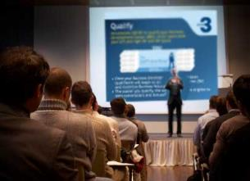
1-on-1
2-on-1
Home Business Presentation (in new persons location)
Group Int.-Business Lunch
Webinars
Meeton.com.
Streaming
Trial Runs
ABC PATTERN
Work as teams
Meeting After the Meeting
Meet
Other
Successful
People
Decision to get started
OR
Set Up Another meeting
UBP Meeting

Slide 11
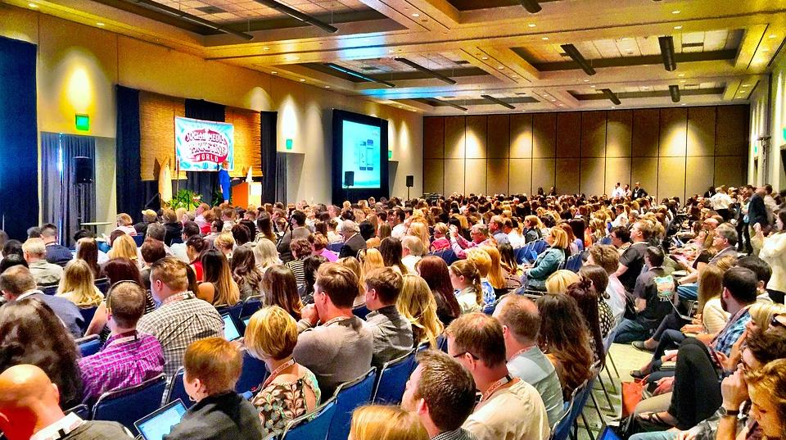
Health
& Nutrition
Skincare
& Cosmetics
ISM
Webcenter
Weight
Management
1 on 1s
2 on 1s
HBP
UBP
NUOT, B5, ECCT
Local Seminar
Annual Convention & Leadership School
International Convention & World Conference

Slide 12


Market America University = GMTSS
Prerequisite
Provides several major and minor subjects choices
School of Business Studies
School of Health and Nutrition
School of Weight Management
School of Personal Care and Cosmetics
School of Website Retailing
School of Internet
Sales & Marketing
UBP
NUOT*
B5
ECCT*
Local Seminar
Annual Convention
Leadership School
Nutrition Product Overview
Antioxidant and free radical
Digestive Health
Eye Health
TLS™
Overview
Motives®
Overview
maWEBCENTERS™ Overview
Shopping Annuity™ Overview,
Assessment
and Training
MA Skin & Personal Care Product Knowledge & Marketing
maWEBCENTERS™
101
201
maWEBCENTERS™
Business Network Event
Social Media
Training
and Workshop
Motives® Brand Introduction, Product Knowledge & Marketing
Motives® Workshops:
Advanced Skin Solutions
All About Eyes
Flawless Face
Online Party Programme
Perfect Pout
SHOP.COM™
Websites,
Tools
and
Applications
Notes:
輔導員提示：
美安大學 = 會議聯盟系統 GMTSS
美安大學架構
左面藍色 (入學先修科目) ，簡短介紹每個課堂
右面 (多個主修科及副修科)，四個以產品為中心既學系。包括………
呢幾個學系, 大家會見到有兩層, 甚至三層0既課程, 意思就係呢d課程係由淺入深0既, 首先係主修科概覽, 然後更深入、專門0既產品知識大家可以學按自己0既喜好，選擇自己想主力 發展0既範疇, 而選擇主修邊一個學科。
要帶出時間管理這個重要概念
美安大學理念，令建立這門生意更事半功倍

Slide 13

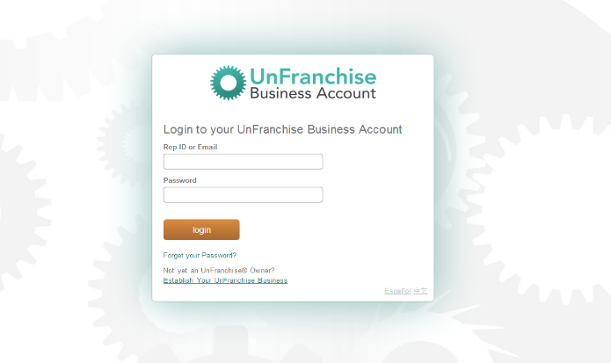
sg.UnFranchise.com

Slide 14
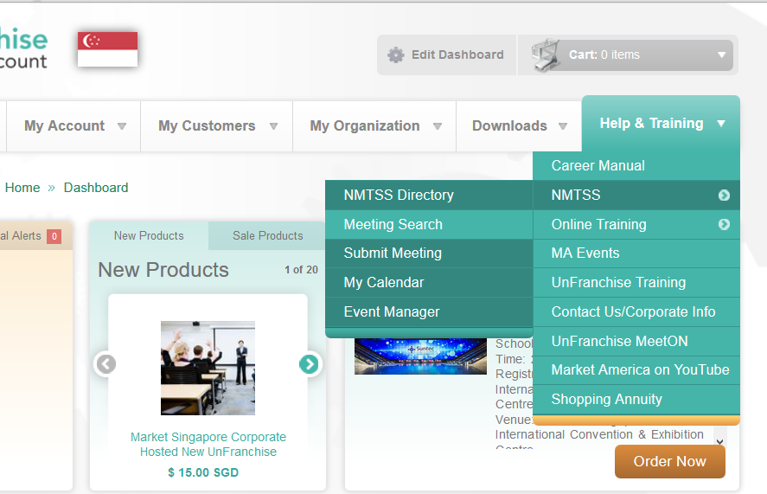

Slide 18
www.unfranchisetraining.com

Slide 20

Ultimate Success In
SHOP . COM™
Financial Freedom
+
Time Freedom
Freedom to Pursue
Our Dream

Slide 21

Leverage on the GMTSS
Time Freedom
=
Plugging your team into the GMTSS

Slide 22

Leverage on the GMTSS
It begins with
YOU
"
Plugging yourself into the system

